Slide 1
Entities, Symbols and Multimedia

Slide 2
Objectives
Entities
Symbols
Multimedia

Slide 3
Introduction to Entities
Reserved characters in HTML must be replaced with character entities.
Characters, not present on your keyboard, can also be replaced by entities
Some characters are reserved in HTML.
If you use the less than (<) or greater than (>) signs in your text, the browser might mix them with tags.
Character entities are used to display reserved characters in HTML.

Slide 4
Entities Syntax
A character entity looks like &entity_name;
OR
&#entity_number;
To display a less than sign (<) we must write: &lt; or &#60;

Slide 5

Some Other Useful HTML Character Entities
Result | Description | Entity Name | Entity Number
 | non-breaking space | &nbsp; | &#160;
< | less than | &lt; | &#60;
> | greater than | &gt; | &#62;
& | ampersand | &amp; | &#38;
¢ | cent | &cent; | &#162;
£ | pound | &pound; | &#163;
¥ | yen | &yen; | &#165;
€ | euro | &euro; | &#8364;
© | copyright | &copy; | &#169;
® | registered trademark | &reg; | &#174;
Entity names are case sensitive.

Slide 6
Combining Diacritical Marks
A diacritical mark is a "glyph" added to a letter.
Some diacritical marks, like grave ( ̀) and acute ( ́) accents.
are called
Diacritical marks can appear both above and below a letter, inside a letter, and between two letters.
Diacritical marks can be used in combination with alphanumeric characters, to produce a character that is not present in the character set (encoding) used in the page.

Slide 7
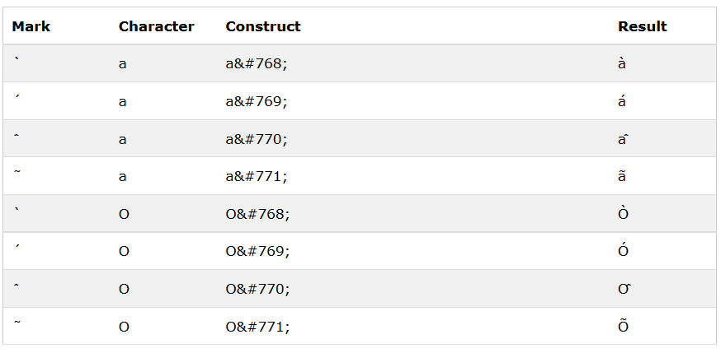
Here are some examples:
Combining Diacritical Marks

Slide 8
HTML Symbol Entities
HTML entities were described in the previous chapter. Many mathematical, technical, and currency symbols, are not present on a normal keyboard.
To add these symbols to an HTML page, you can use an HTML entity name.
If no entity name exists, you can use an entity number; a decimal (or hexadecimal) reference.

Slide 9
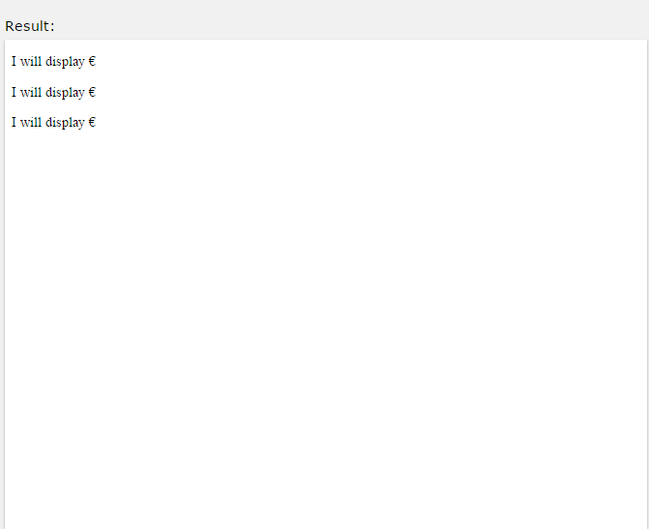
HTML Symbol Entities
<p>I will display &euro;</p>
<p>I will display &#8364;</p>
<p>I will display &#x20AC;</p>

Slide 10
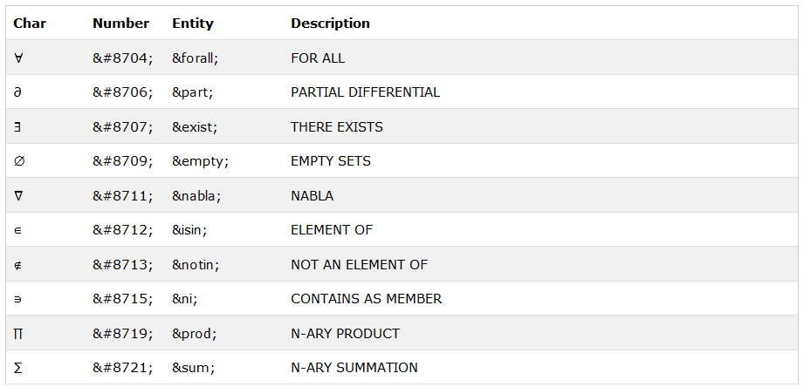
Some Mathematical Symbols Supported by HTML

Slide 11
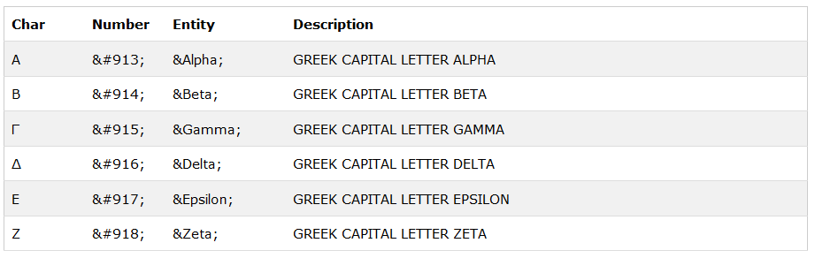
Some Greek Letters Supported by HTML

Slide 12
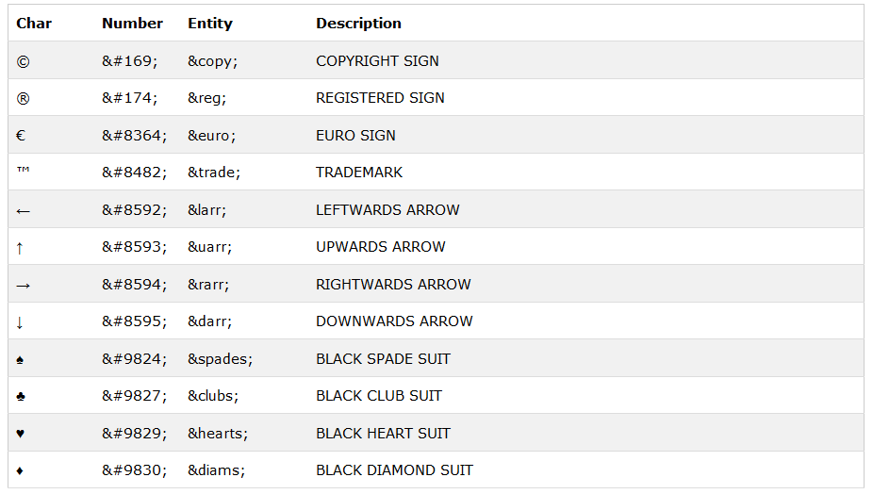
Some Other Entities Supported by HTML

Slide 13
What is Multimedia?
Multimedia
Multimedia comes in many different formats. It can be almost anything you can hear or see.
Examples: Pictures, music, sound, videos, records, films, animations, and more.
Web pages often contain multimedia elements of different types and formats.

Slide 14

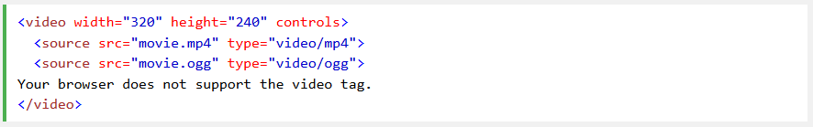
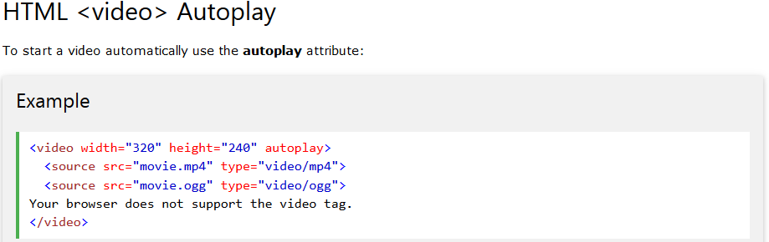
HTML5 Video
Browser Support

Slide 15

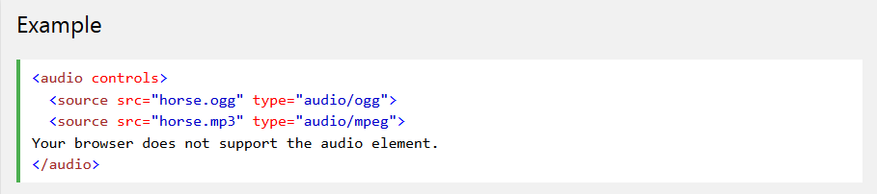
HTML5 Audio
Browser Support

Slide 16
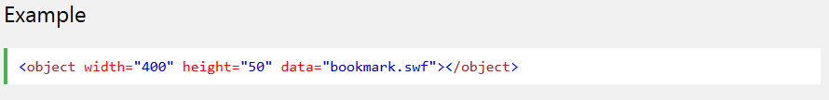
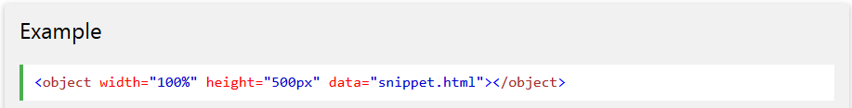
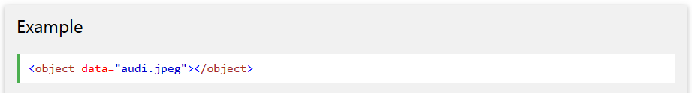
HTML Plug-ins
The <object> Element
The <object> element is supported by all browsers.
The <object> element defines an embedded object within an HTML document.
It is used to embed plug-ins (like Java applets, PDF readers, Flash Players) in web pages.

Slide 17
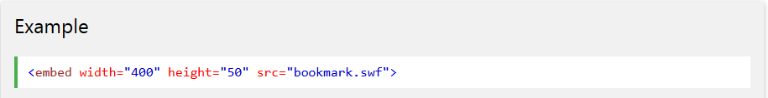
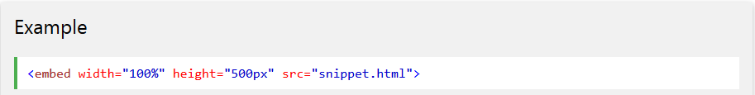
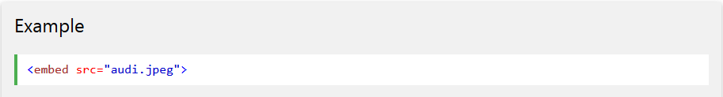
The <embed> Element
The <embed> element is supported in all major browsers.
The <embed> element also defines an embedded object within an HTML document.
Web browsers have supported the <embed> element for a long time. However, it has not been a part of the HTML specification before HTML5. The element will validate in an HTML5 page, but not in an HTML 4 page

Slide 18
HTML YouTube Videos
Struggling with Video Formats?
Different versions of different browsers support different video formats.
Earlier in this tutorial, you have seen that you might have to convert your videos to different video formats to make them play in all browsers.
Converting videos to different format can be difficult and time consuming.
An easier solution might be to let YouTube play the videos in your web page

Slide 19
YouTube Video Id
YouTube will display an id (like XGSy3_Czz8k), when you save (or play) a video.
You can use this id, and refer to your video in HTML.

Slide 20
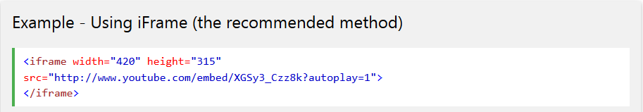
Playing a YouTube Video in HTML
To play your video on a web page, do the following:
Upload the video to YouTube
Take a note of the video id
Define an <iframe> element in your web page
Let the src attribute point to the video URL
Use the width and height attributes to specify the dimension of the player
Add any other parameters to the URL

Slide 21
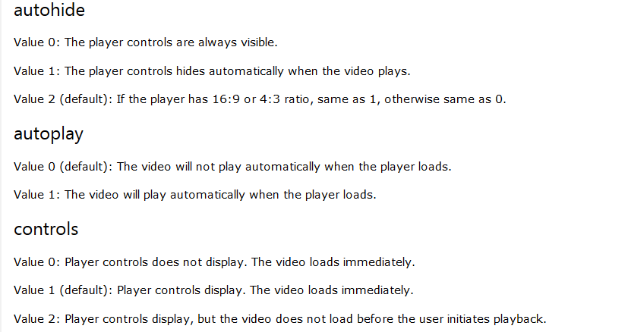
YouTube Parameters

Slide 22
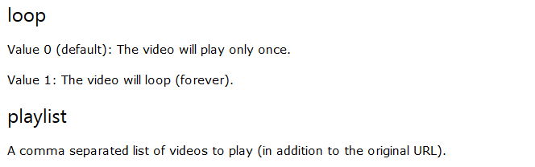
YouTube Parameters

Slide 23
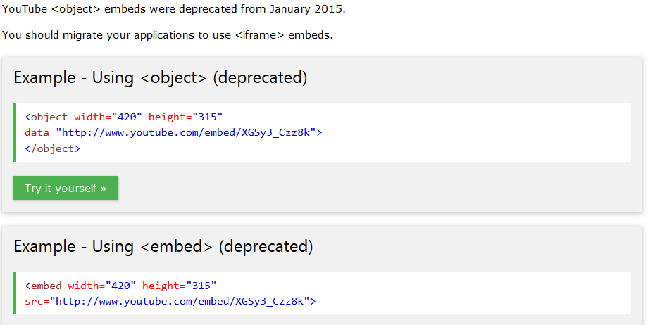
YouTube <object> Embeds

